Slide 1
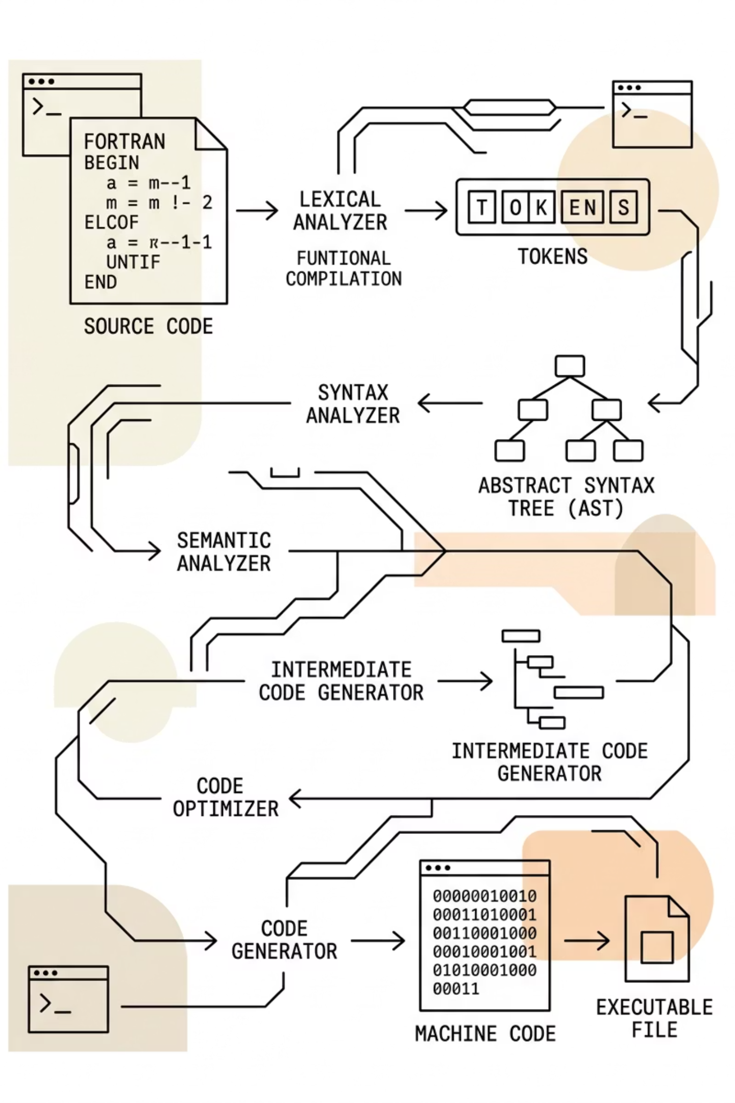
F-Lite: A FORTRAN-Inspired Compiler with Algorithmic NLP Diagnostics
A Zero-Dependency Implementation of a Full Compiler Pipeline
Objective
Demonstrate a deep understanding of compiler theory by building a scanner, parser, and code generator from scratch in C++14.
Key Innovation
Integration of "Light NLP" algorithms (Levenshtein Distance and Bigram Hinting) to improve developer experience through smart diagnostics.
Platform
Features both a CLI tool and an interactive web-based visualizer.

Slide 2
Language Specification & Architecture
The F-Lite DSL
Inspiration
The Pipeline
Captures the spirit of FORTRAN (imperative, line-based, case-insensitive).
01
Lexical Analysis
Core Features
DFA-based scanner (no Flex).
32-bit integers
1D arrays
IF/THEN/ELSE logic
DO loops
Subroutines
02
Syntax Analysis
Recursive Descent Parser (no Bison).
03
Intermediate Representation
Three-Address Code (TAC).
04
Backend
Target Assembly generation for a virtual 4-register machine.

Slide 3
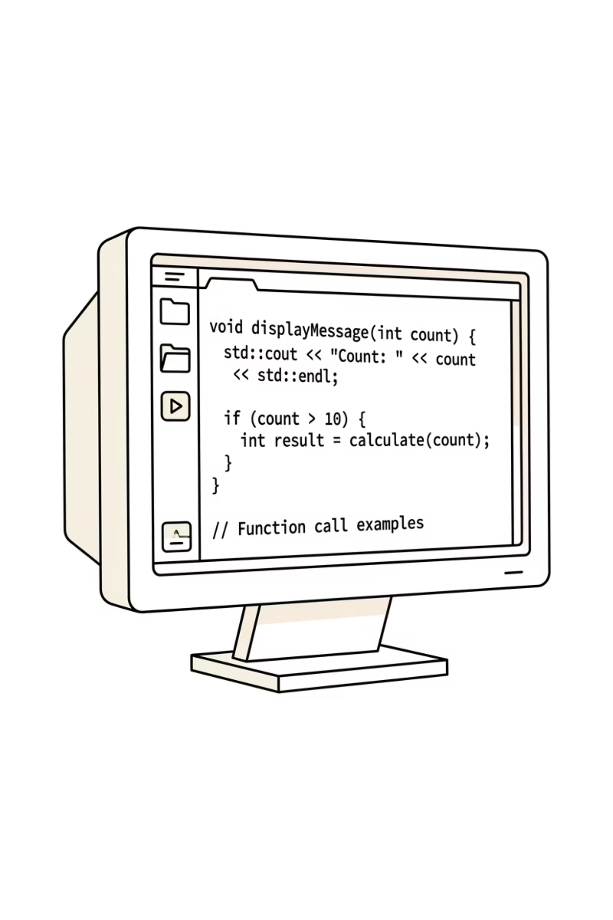
Lexical & Syntax Analysis
Manual Frontend Implementation
Scanner (scanner.cpp)
Handles case-insensitivity and FORTRAN-style operators (e.g., .LT., .GE.).
Implements a custom DFA for identifiers, literals, and strings.
Parser (parser.cpp)
Uses a Recursive Descent strategy based on EBNF grammar.
Panic-Mode Recovery: Synchronizes at line boundaries or keywords to report multiple errors per pass.
Syntax-Directed Translation: Emits TAC instructions directly during parsing.

Slide 4
NLP-Enhanced Diagnostics
Improving Error Clarity
Levenshtein Distance
Bigram-Based Hinting
Measures the "edit distance" between unknown tokens and reserved keywords.
Automatically suggests corrections (e.g., "Did you mean INTEGER?" for the typo INTGER).
A deterministic model derived from the formal grammar.
Predicts what should have followed based on the previous token.
Example: After an IF keyword, the compiler explicitly hints that an open parenthesis ( is expected.

Slide 5
Intermediate & Target Code Generation
From Source to Assembly
Three-Address Code (TAC)
Target Assembly
Listing File (.lst)
Translates TAC into a low-level instruction set (LOAD, STORE, CMP, JMP).
Manages a limited register set (–) and basic stack operations for subroutines.
Generates an annotated output file where errors are interleaved directly with source code.
Flattens complex expressions into simple instructions.
Simplifies control flow into labels and conditional jumps.

Slide 6
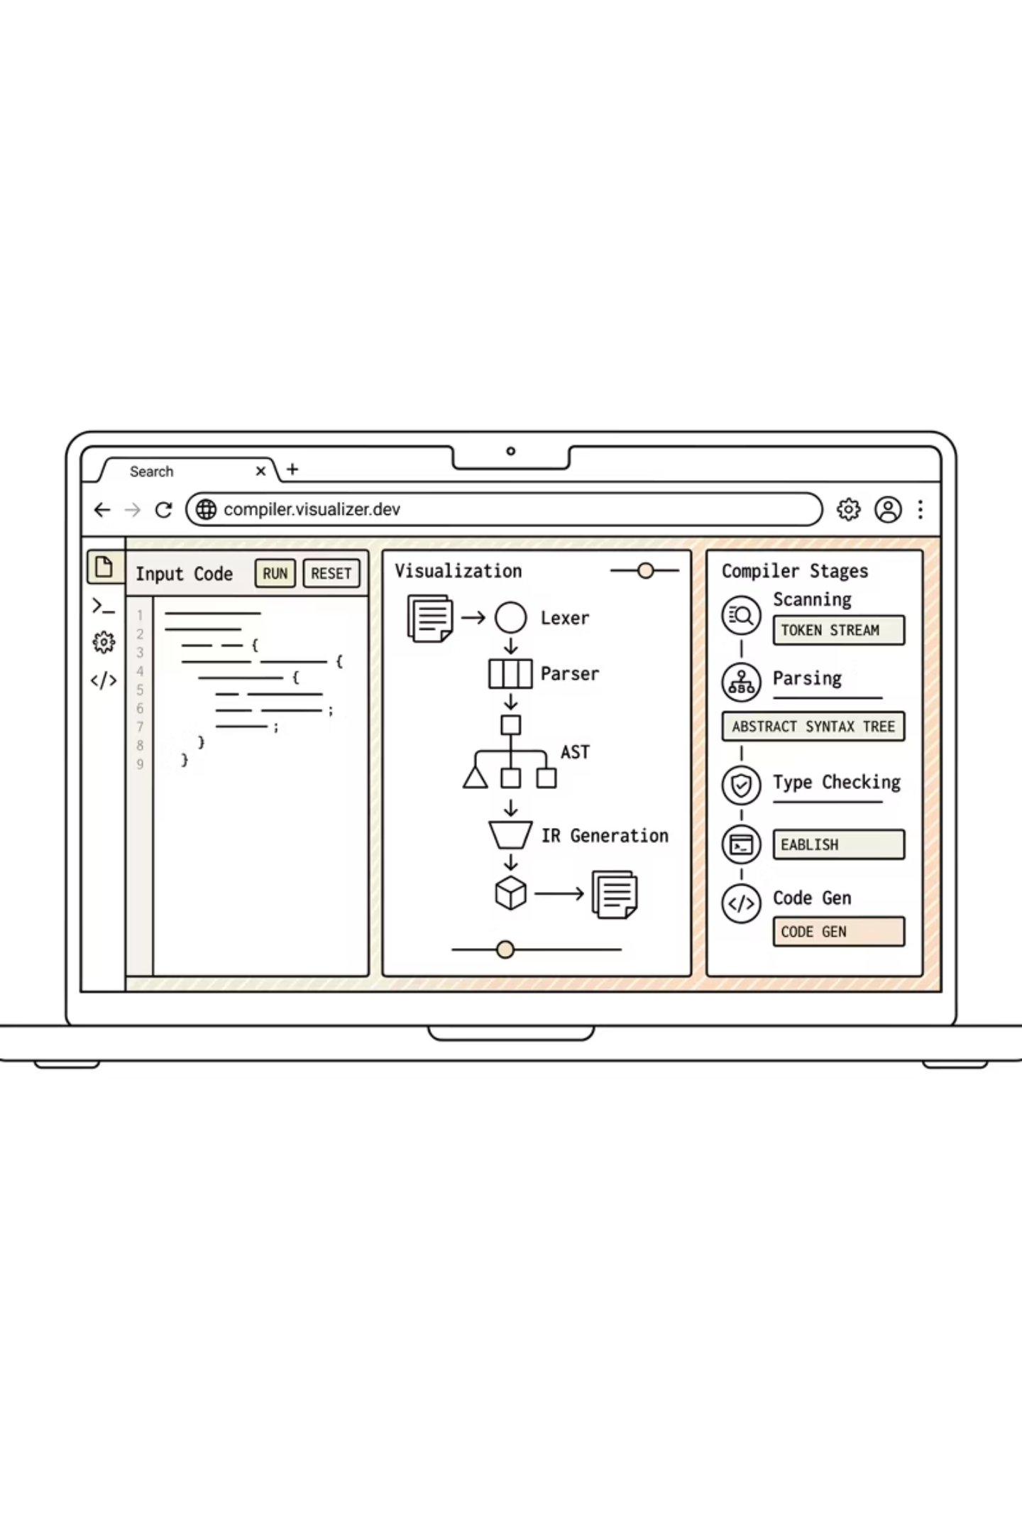

Interactive Web Visualizer
The Teaching Tool
Architecture
A full JavaScript port of the C++ compiler engine running entirely in-browser.
Phase Stepping
Allows users to view the state of the compiler at every stage.
Visual Mapping
Color-coded tokens, TAC instructions, and Assembly categories.
Live Diagnostics
Displays Levenshtein badges and bigram hints in an interactive UI.
Conclusion: F-Lite proves that robust, modern diagnostics can be integrated into low-level systems without external dependencies.

